Slide 1
Social Media Examples
Need the perfect gift for your valentine this year? Buy a carnation from Phi Mu in the quad today and help us raise funds for @PhiMuFoundation! All proceeds benefit programs to advance the lifetime development of women just like you and me! #marymarymartha #give1852
Join us at Russo’s BBQ on 3/22 for @PhiMuFoundation night! Russo’s is donating 15% of their net sales to Phi Mu Foundation to help fund initiatives like scholarships and leadership programs for our sisters! #marymarymartha #give1852
Feeling lucky? Swing by the Phi Mu house today from 2-5 p.m. and bid on items for our @PhiMuFoundation Silent Auction! Funds raised from the silent auction will help Phi Mu sisters across the country pursue their dreams! #marymarymartha #give1852
Every member in our chapter has committed to donating $18.52 to @PhiMuFoundation in honor of our Founders during the month of March. Will you join us in raising money to help support leadership and educational opportunities for women? phimufoundation.org/give #marymarymartha #give1852

Slide 2
Social Media Examples
There’s no better way to celebrate the founding of Phi Mu than with a gift of $18.52! Join <insert chapter name> in honoring our three founders today with a contribution to Phi Mu Foundation #MaryMaryMartha
March is our favorite time of the year…celebrating Phi Mu Founders Day and the M3 Campaign! Phi Mu sisters – will YOU join us in supporting our sisterhood and making a gift in honor of our Founders? #MaryMaryMartha
Happy Founders Day to my Phi Mu sisters! I’m thankful #MaryMaryMartha got together at Wesleyan College 167 years ago today to establish a sisterhood I’m proud to call my own.
We are challenging {insert name of collegiate and/or alumnae chapter} sisters to contribution of $167 to Phi Mu Foundation for the M3 Campaign, in honor of our 167th anniversary! #MaryMaryMartha

Slide 3
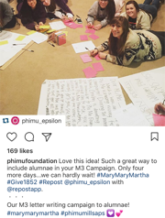
Social Media Examples
Did you know Phi Mu Foundation provides scholarship, leadership and emergency assistance to our sisters? Help sustain these programs by contributing to the M3 Campaign today! #MaryMaryMartha
Want to know why I give to Phi Mu Foundation? They made a difference in my life. Now, it’s up to me to help make a difference for someone else. Join me in supporting the M3 Campaign! #MaryMaryMartha

Slide 4
Social Media Examples
#marymarymartha

Slide 5
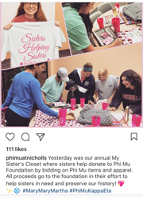
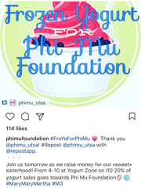
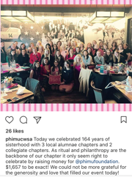
Social Media Examples

